Slide 1
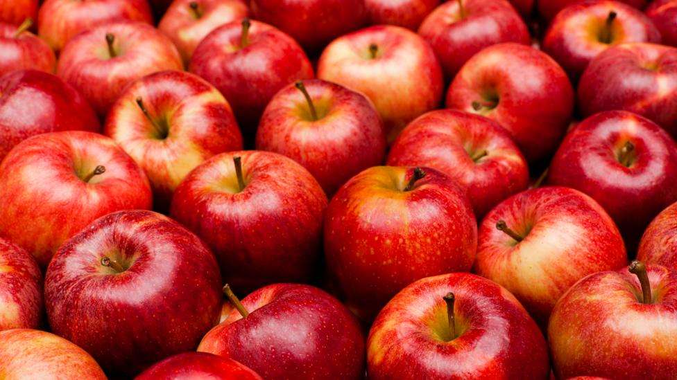
Stress Impact on Health
Zaira Datieva
International School of Tomorrow
“To everything there is a season,
and a time to every person under the heaven.”
Ecclesiastes 3:1
CLICK TO CONTINUE

Slide 2
NAVIGATION AID
KEY:
Press any slide on the CONTENT page
TITLE SLIDE BUTTON
CONTENT SLIDE BUTTON
NAVIGATION SLIDE BUTTON
NEXT SLIDE BUTTON

Slide 3
CONTENT PAGE

Slide 4
SYMPTOMS OF STRESS
Depression
Anxiety
Irritability
Memory and concentration problems
Compulsive behavior
Mood swings

Slide 5
BRAIN AND NERVES
Stress can kill brain cells
It can reduce the size of the brain
When experiencing a stressful event, amygdala, one part of the brain send’s a distress signal to the command center of the brain, the hypothalamus, which triggers a fight or flight response. This can result in:
Increased heartrate
Heightened senses
Deeper intake of oxygen
The rush of adrenaline

Slide 6
ADDITIONAL EFFECTS MAY INCLUDE:
Headaches
Feeling of despair
Lack of energy
Sadness
Nervousness
Anger
Irritability
Trouble concentrating
Memory problems
Difficulty sleeping
Mental health disorders (anxiety, panic attacks, depression,etc.)

Slide 7
THE HEART
Stress itself can increase risk of heart disease.
It can cause a raise in blood pressure.
It can change the way blood clots, which can result in a heart attack.
It may affect behaviors and factors that increase heart disease risk:
High blood pressure and cholesterol levels
Smoking
Physical inactivity
overeating

Slide 8
THE STOMACH AND DIGESTION
Stress can affect your digestive system by causing your esophagus to go into spasms. This increases the acid levels in your stomach which ultimately leads to indigestion.
Short term effects may include:
Stomach aches
Nausea
Diarrhea
Long term effects may include:
Prolonged stress which can cause aggravation of certain chronic diseases like
-irritable bowel syndrome

Slide 9
THE PANCREAS
By triggering the fight-or-flight hormones, stress can accelerate the development of pancreatic cancer.
With stress, the induction of acute pancreatitis is more severe than without it.
Stress can also increase the risk of diabetes.

Slide 10
OTHER EFFECTS
Skin problems (such as acne)
Muscle aches and tension
Increased risk for low bone density
Weakening of the immune system

